Slide 1
STUDENT TEMPLATE
SENSE
Smart Coaster — Hydration Tracker
PROCESS
COMMUNICATE
POWER
ACTUATE
Advanced IoT Systems
KLE Technological University • ECE Department
Notes:
Template for student teams to document their IoT product teardown. Duplicate and fill in all placeholders.

Slide 2
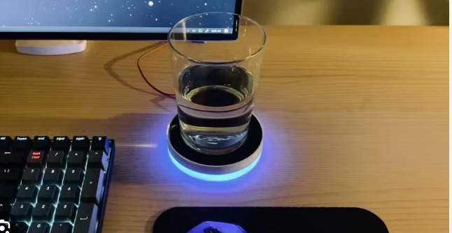
PROBLEM STATEMENT:
Most people fail to drink adequate water daily, leading to fatigue, headaches, and reduced cognitive performance. Existing hydration trackers require manual logging or smart bottles that are expensive and bottle-specific. No passive tracking solution exists for any cup or glass.
Notes:
Fill in product details. Take a clean photo before disassembly.

Slide 3
BLOCK DIAGRAM:
Map the product to the five IoT subsystems
SENSE
PROCESS
COMMUNICATE
POWER
ACTUATE
→
→
→
→
Sensors &
Transducers
MCU / SoC
& Memory
Wireless
Radio
Supply &
Regulation
Outputs &
Feedback
Sense
Process
Communicate
Power
Actuate
Load Cell Sensor( 1 KG)
1000mAh Lipo+TP4056 USB-C
OLED Display
→
HX711 24 bit ADC(5 Hz)
ESP 32
RTC (DS3231/DS1307)
→
BLE 5.0 GATT
App
→
→
Notes:
Most important slide. Draw the architecture showing how 5 subsystems interconnect.

Slide 4
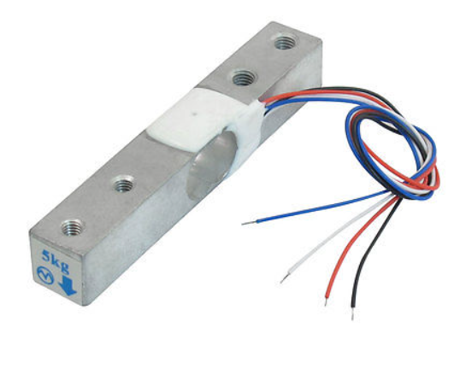
Sense — Sensors & Transducers
Identify all sensing elements and their interfaces
1) Load Cell Sensor( 1Kg)
Why?
Converts weight into electrical signal
Works with any container (no fixed container needed)
Provides continuous weight measurement
Detects very small changes
Type : Load Cell / Weight Sensor
Capacity : 1 kg
Function: Measures the weight of the cup and water
Supply Voltage : 5V (via HX711)
Notes:
For each sensor, read IC markings and find the datasheet. Include close-up photos of sensor ICs and their placement context on the board.

Slide 5
Process — MCU / SoC & Memory
Identify the processing core, memory, and peripherals
2)HX711(24 Bit ADC)
Why?
Amplifies very small signal from load cell
Converts analog signal → digital data
Enables microcontroller to read weight values
Type:HX711 Load Cell Amplifier + ADC
Interface: I2C communication
3)RTC
Less clock drift
Easy to Interface (I2C Communication)
Which works easily with ESP32
Why?
Type : RTC Module
Function : Maintains time and triggers events like reset and reminders
Interface : I2C Protocol
Notes:
Main MCU/SoC is usually the largest IC. Include photos showing the chip markings clearly and the surrounding decoupling/crystal circuit.

Slide 6
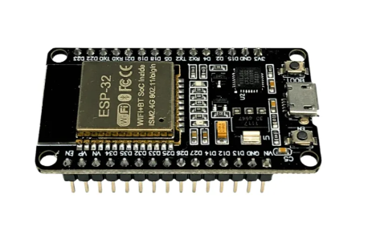
4) ESP 32
Why?
Processes weight data from HX711
Performs sip detection & intake calculation
Supports BLE communication
Controls display, buzzer, and timer functions
Type :Microcontroller (ESP32 SoC)
Core :Dual-core processor
Function :Reads sensor data, processes logic, controls output devices, and manages communication
Interfaces :GPIO, I2C (OLED), SPI, UART, BLE
Notes:
For each sensor, read IC markings and find the datasheet. Include close-up photos of sensor ICs and their placement context on the board.

Slide 7
Communicate — Wireless & Connectivity
Identify wireless protocols, RF components, and antenna design
5)BLE 5.0 GATT
Why?
Enables wireless data transfer
Sends hydration data to mobile app
Supports low power operation
Provides real-time notifications
Type : Wireless Communication (BLE 5.0)
Function : Transfers intake data and alerts between ESP32 and mobile device
Range : ~10 meters
Frequency : 2.4 GHz
Notes:
Photo the antenna structure and ground clearance zone. Show the radio IC markings clearly.

Slide 8
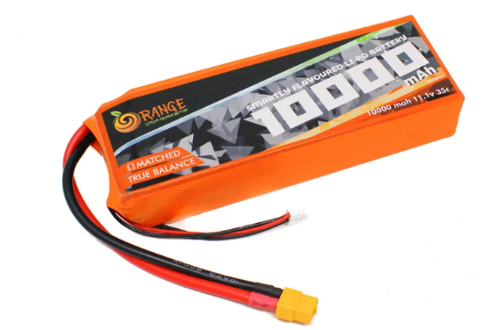
Power — Supply & Regulation
Trace the complete power path from input to every rail
6) 1000mAh Lipo+TP4056 USB-C
Why?
Provides portable power supply
Supports rechargeable battery operation
Enables USB-C charging
Ensures continuous system operation
Type : LiPo Battery + Charging Module
Battery Capacity : 1000 mAh
Function : Supplies power to ESP32, HX711, OLED, and buzzer
Charging Module : TP4056 (USB-C input)
Notes:
Photo the power section — regulators, inductors, capacitors. Show the input connector or battery area.

Slide 9
Actuate — Outputs & Feedback
Identify all output and actuation elements
7) OLED
Why?
Low power consumption
Compact and light weight
Fast response time
Suitable for portable systems
Type : OLED Display (I2C Interface)
Size : 0.96 inch (128 × 64 pixels)
Function : Displays intake data, progress bar, and system status
Notes:
Photo actuators — speakers, LEDs, motors, displays. Show driver ICs and their surrounding circuit.

Slide 10
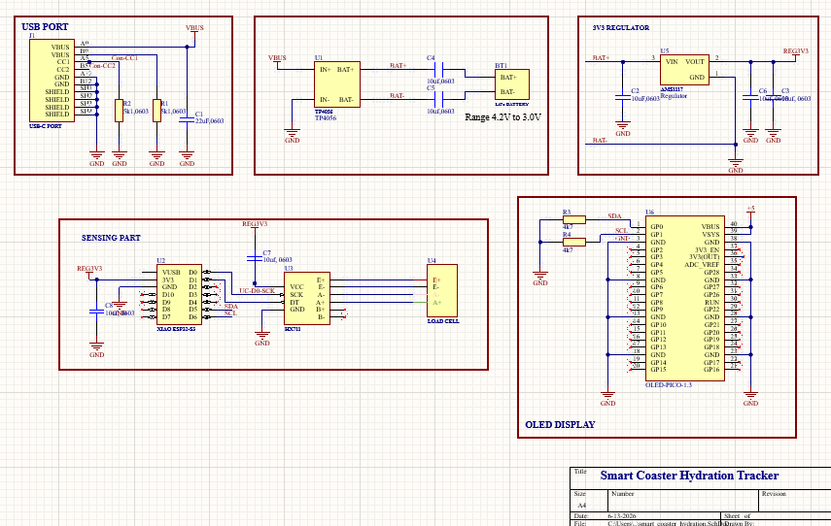
Schematic walkthrough: Analog ground strategy
I
Benefits Achieved
Reduced noise coupling
More stable readings
Better gram-level accuracy
Improved repeatability
Notes:
Photo actuators — speakers, LEDs, motors, displays. Show driver ICs and their surrounding circuit.

Slide 11
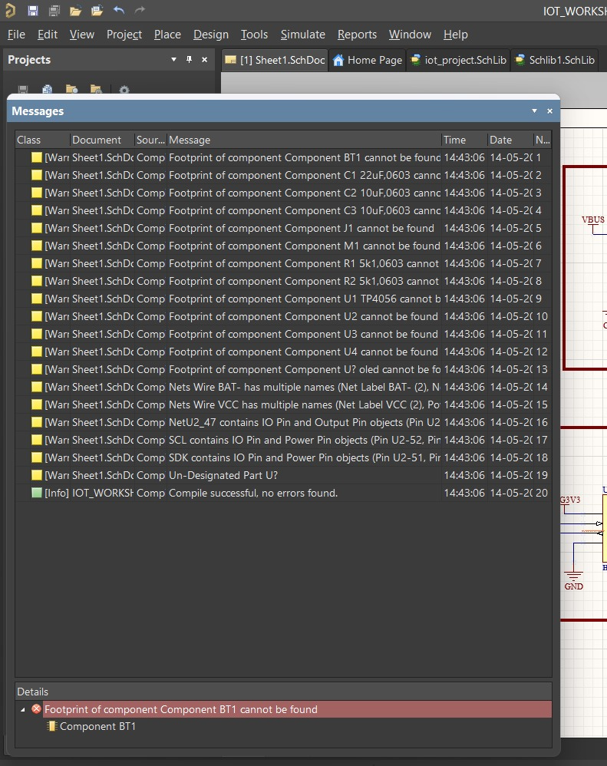
ERC report
I
The schematic design was verified using Electrical Rule Check (ERC) in Altium Designer.
All electrical connections, power nets, and signal paths were validated successfully.
The design meets all required electrical constraints and is ready for implementation.
Notes:
Photo actuators — speakers, LEDs, motors, displays. Show driver ICs and their surrounding circuit.

Slide 12
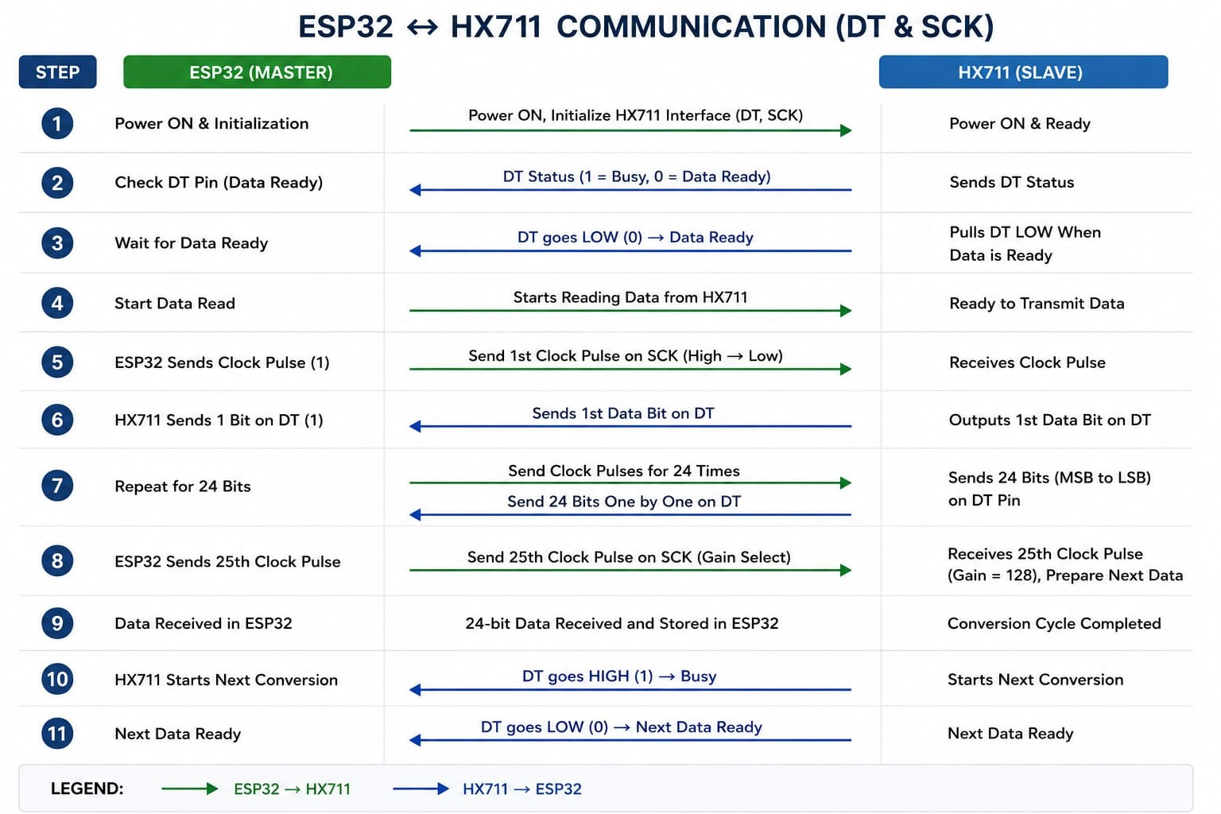
Software Architecture
1.Drivers

Slide 13
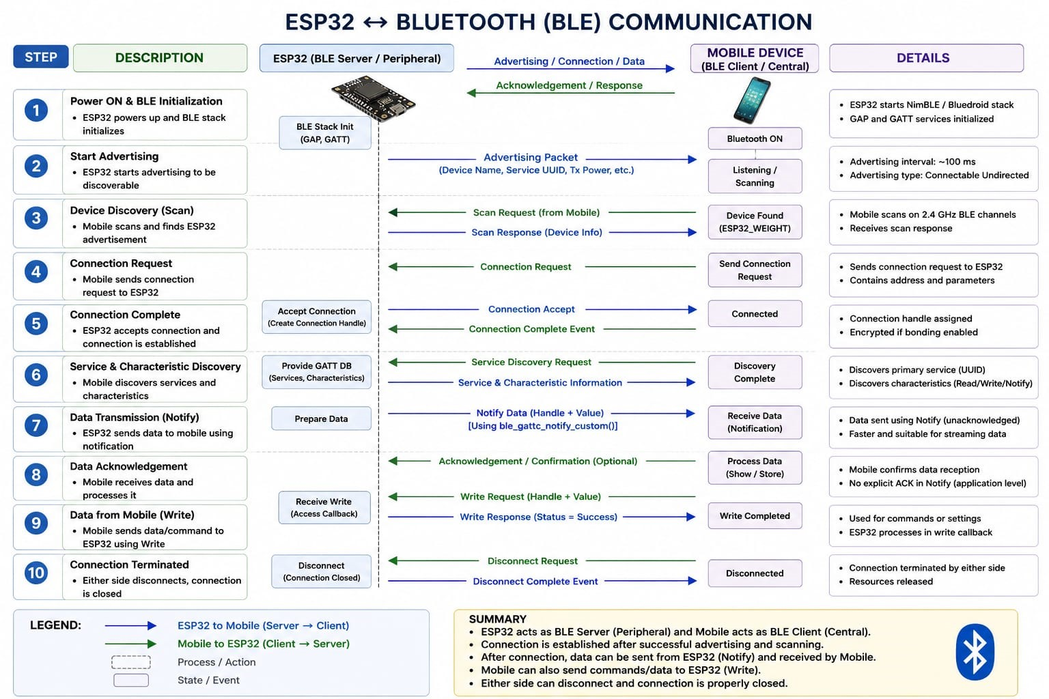
2.Communication

Slide 14
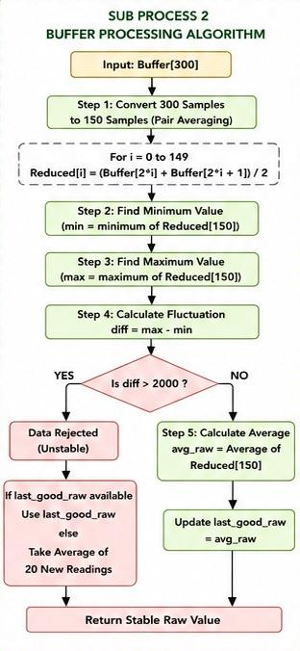
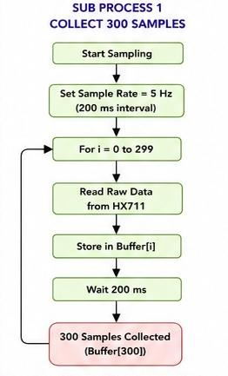
3.Algorithm

Slide 15
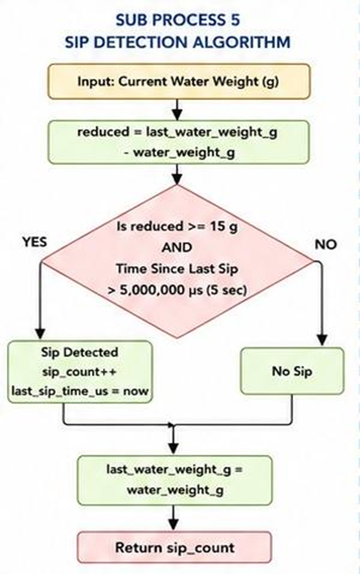
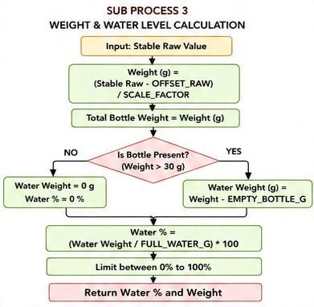

Slide 16
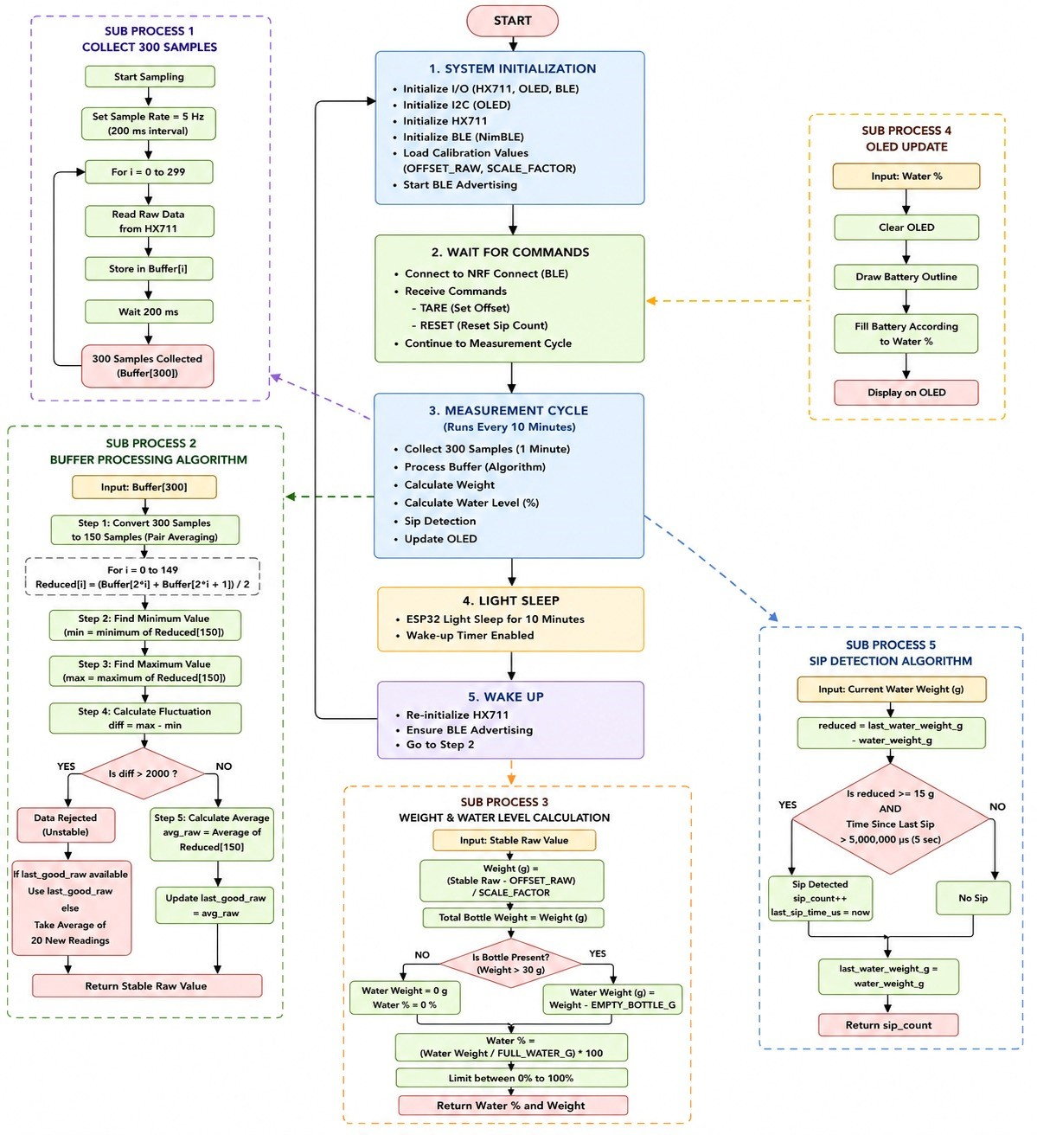
Detailed Architecture

Slide 17
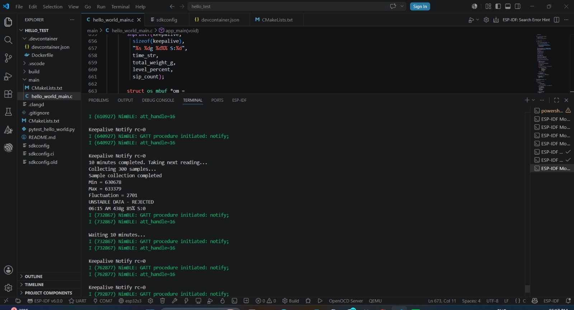
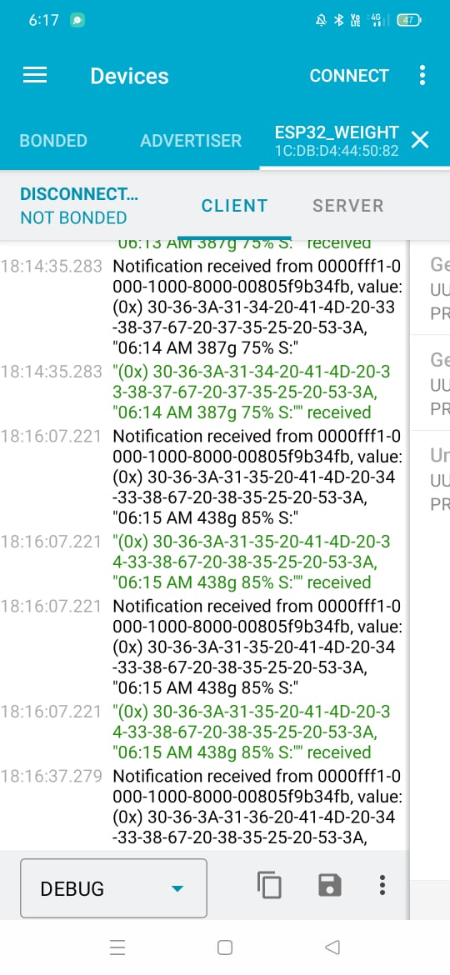
Result Screenshots

Slide 18
BOM:
S.No | Components | Specification | Quantity | Price
1 | ESP32 Dev Board | 3.3V, Dual-core, BLE + WiFi | 1 | ₹350 – ₹500
2 | Load cell | 5kg, Strain Gauge Type | 1 | ₹150 – ₹300
3 | HX711 Module | 24-bit ADC, Gain 128/64 | 1 | ₹80– ₹150
4 | OLED Display | 0.96”, 128×64, I2C | 1 | ₹120– ₹200
5 | RTC module | I2C, High accuracy, battery backup | 1 | ₹150– ₹250
6 | LiPo Battery | 3.7V, 1000mAh | 1 | ₹150– ₹300
7 | TP4056 Module | LiPo charger, Type-C/Micro USB | 1 | ₹50– ₹100
8 | PCB / Breadboard | Protype board | 1 | ₹100– ₹200
Notes:
Photo actuators — speakers, LEDs, motors, displays. Show driver ICs and their surrounding circuit.

Slide 19
S.No | Components | Specification | Quantity | Price
9 | LED | 3.3V compatible | 1 | ₹10– ₹30
10 | Resistors | 220Ω (for LED) | 2-3 | ₹1
11 | Connecting wires | Jumper wires | 1 set | ₹50– ₹100
12 | USB cable | Type-C / Micro USB | 1 | ₹50– ₹150

Slide 20
Power Budget
I
Components | Voltage(V) | Current (mA) | Power(mW)
ESP32 (Active + BLE) | 3.3 | 80-150 | 264-495
ESP32 (Avg) | 3.3 | 80 | 264
ESP32 (Sleep) | 3.3 | 0.01-0.15 | 0.03-05
HX711 | 3.3 | 1.5 | 5
Load Cel | 3.3 | 1 | 3.3
OLED display | 3.3 | 15-25 | 50-82
RTC | 3.3 | 0.2 | 0.66
LED | 3.3 | 5-10 | 16.5-33
Notes:
Photo actuators — speakers, LEDs, motors, displays. Show driver ICs and their surrounding circuit.

Slide 21
Teardown Summary
Team Information
Submission Checklist
Team Name: Connective Minds
Topic : Smart Coaster Hydration
Members:
1. Aishwarya Y 01FE23BEC267
2. Nikhita Naik 01FE23BEC270
3. Sahana I G 01FE23BEC284
4. Vani S K 01FE23BEC285
Product overview with photo
System block diagram (5 subsystems)
Sense — ICs, interfaces, 3–4 features each
Process — MCU/SoC, memory, peripherals
Communicate — Protocol, antenna, RF details
Power — Full supply chain, regulators
Actuate — Outputs, drivers, feedback
Annotated PCB photos (front & back)
Complete component map with datasheets
Key learnings and observations
Notes:
Every checklist item should be completed before submission.

